Slide 1

Video Games!
Team members: Weifei Yan, Yunguo Cai, Runhe Lu
Yunguo Cai, Wenfei Yan, Runhe Lu
STATS 415 Final Project

Slide 2
Agenda
Goals
Dataset Exploration
Model Selection
Conclusion

Slide 3
Goals
Predict global sales of video games
Best predictors

Slide 4
Dataset
Video Game Sales:
A Kaggle reviewed dataset
16,791 games
1973 to 2017
Variables used:
Global sales(numeric) response
Critic score(numeric)
User count(numeric)
Critic count(numeric)
User score(numeric)
Genre
Developer
Platform
Release Year

Slide 5
Preprocessing Data
Missing Values:
9702 (58%) records have missing values
All missing values occur in variables “Critic_Score”, “Critic_Count”, "User_Count", “User_Score”
Most missing values are old games(1970s-1990s)
Remove all the records with missing values!
Notes:
这里大概说一下missing values的分布情况。
然后说因为缺的都是挺重要的(critic score什么的)，所以我们把有na的行全删了

Slide 6
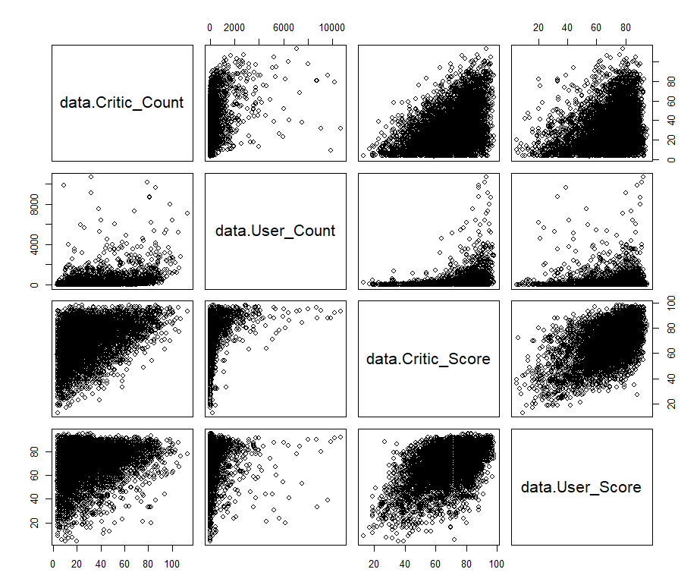
User score & Critic score
Highly correlated
Linear regression
might not be good

Slide 7
Year of release vs sales
Release year affects sales?
Notes:
See whether sales varies among different genres

Slide 8
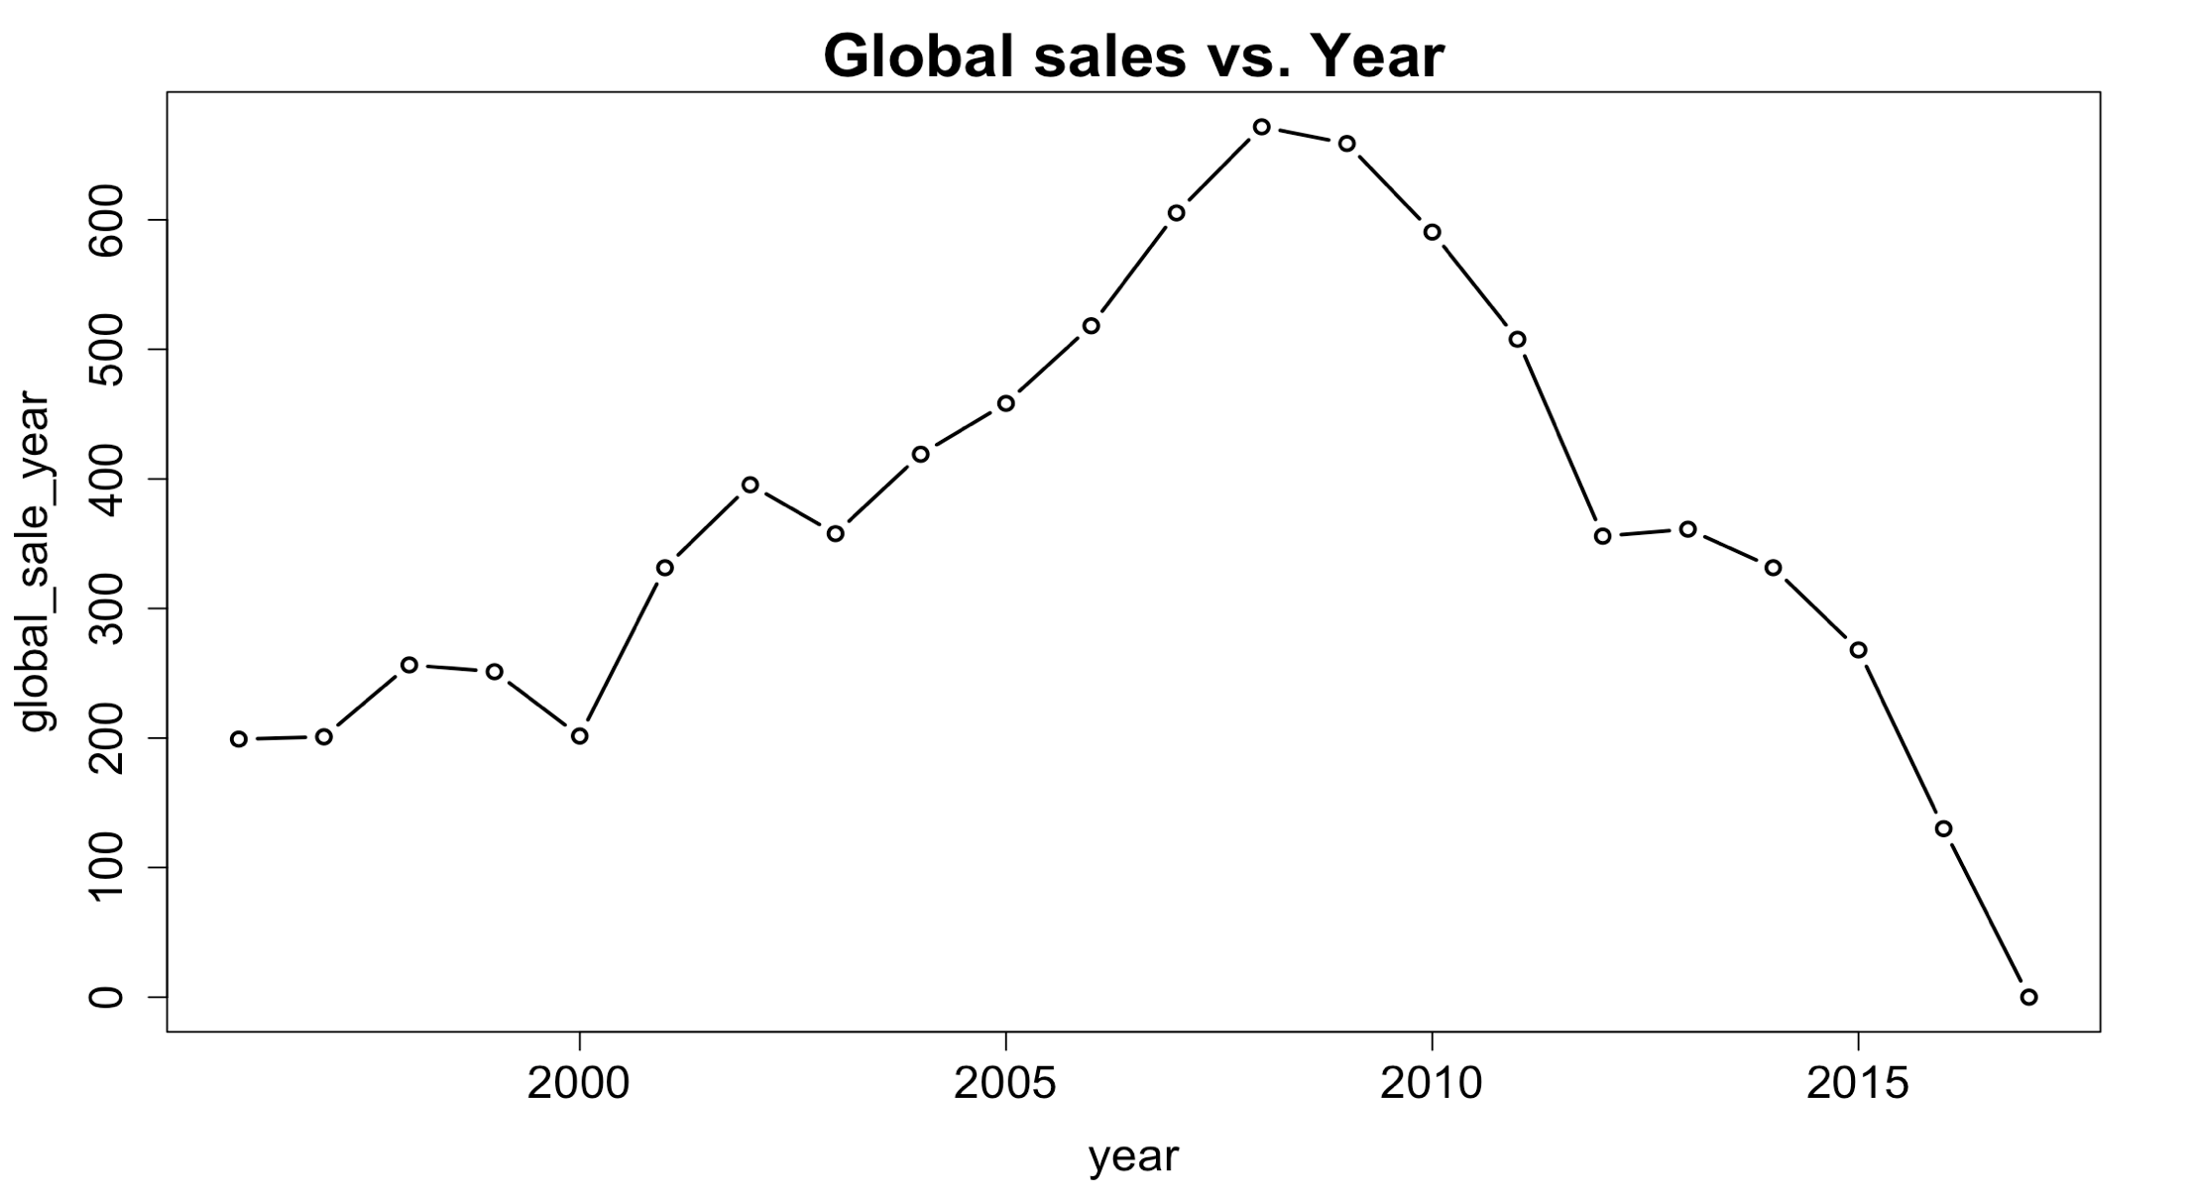

Slide 9
Year of release vs sales
Games release on different years have different
sales
Not a useful predictor
Games released for 5 years would have a larger sale than games released for only 1 year
Notes:
See whether sales varies among different genres

Slide 10
Genre
Is genre a good predictor?
Are different kinds of games performs differently on sale amount?
Notes:
See whether sales varies among different genres

Slide 11
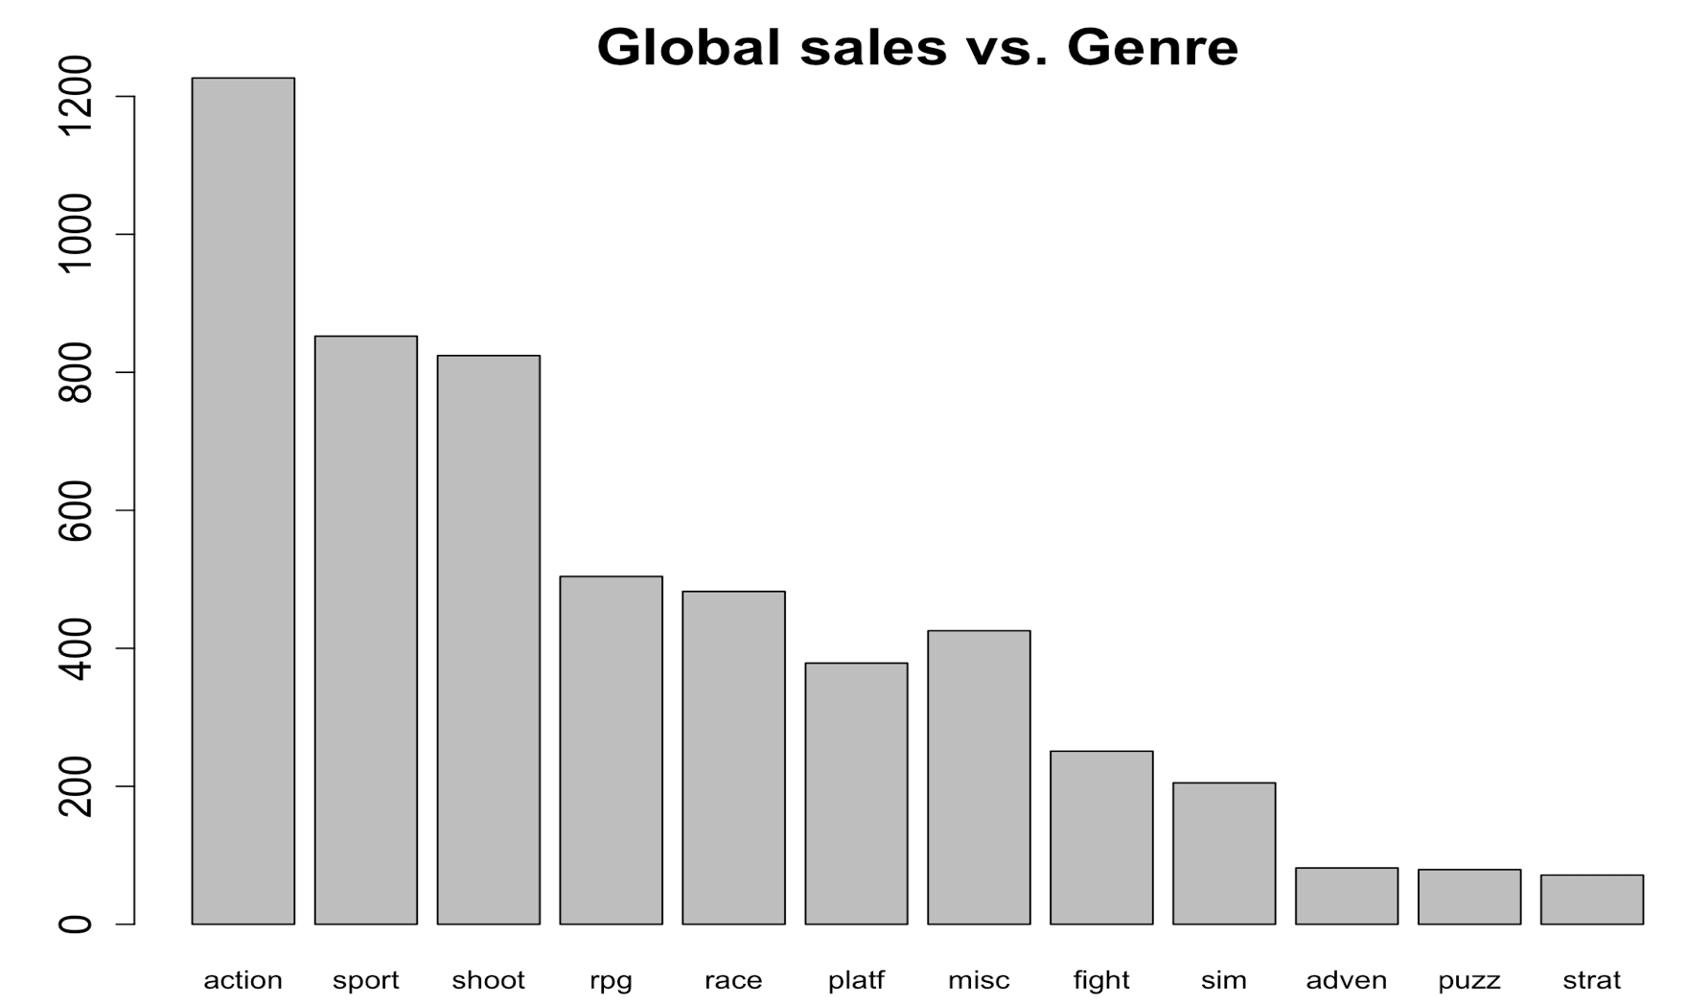

Slide 12
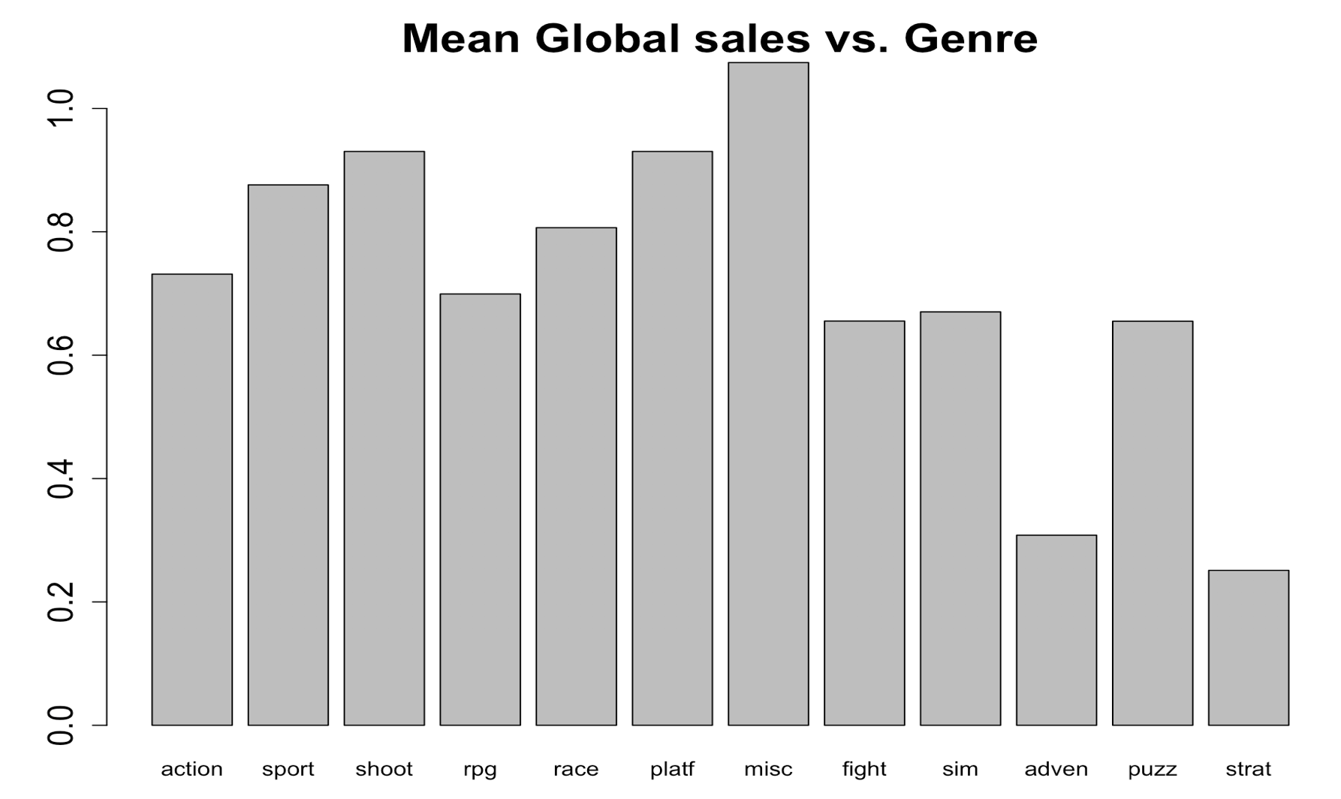

Slide 13
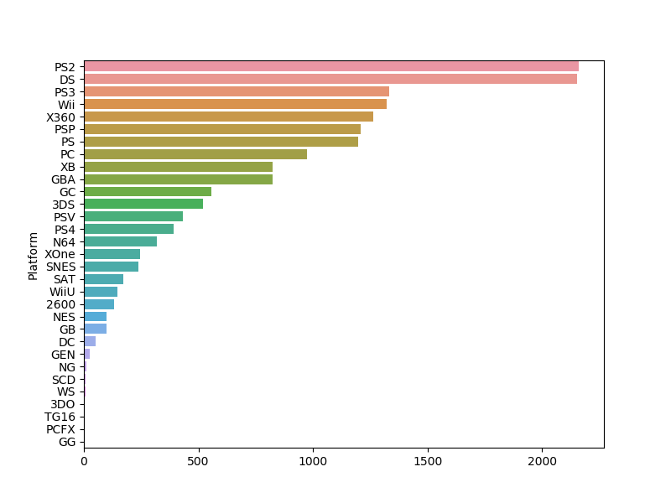
Platform vs Sale
Best platform: PS series
Potential predictor
Notes:
See whether sales varies among different platforms

Slide 14
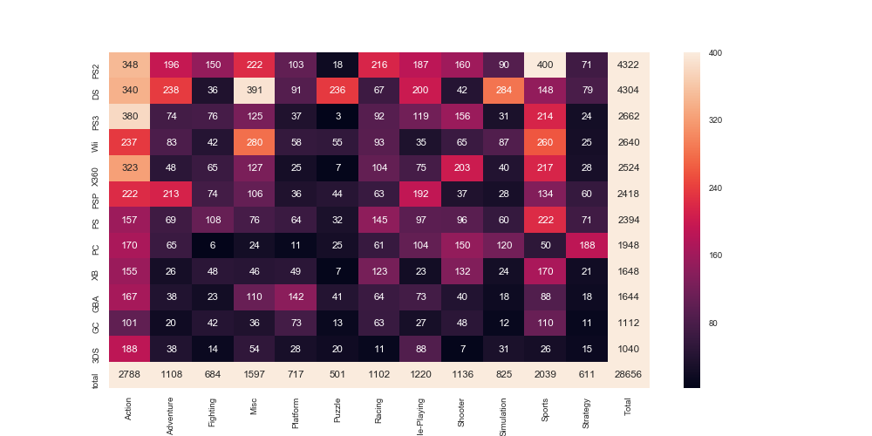
Heatmap
Notes:
Heatmap of platforms and genres
Does the platforms have their own preference on games? (which might influence the sales, or actually, influenced by the sales)
Wii-misc, sports
PS3-sports
DS-adventure, Misc, puzzle, role-playing, simulation
PS2- Misc,Racing, Sports

Slide 15
Model Selection
Linear Regression with OLS
KNN Regression
Lasso Regression
Ridge Regression

Slide 16
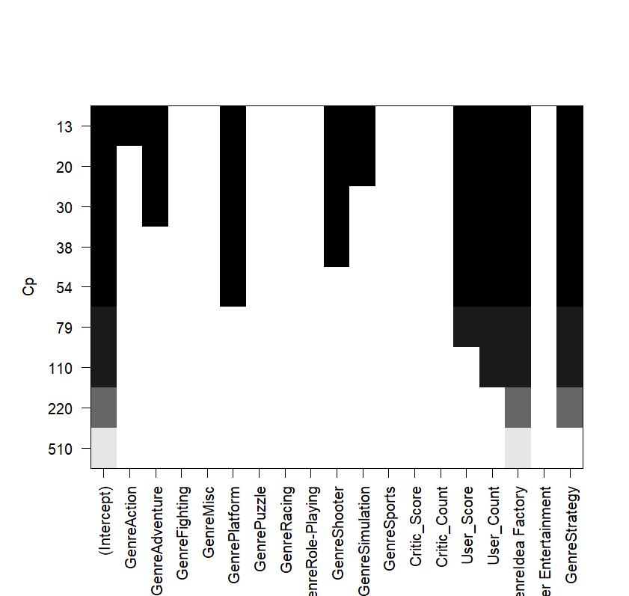
Variable Selection
CP:
User_score,
Genre, User_count

Slide 17

Variable Selection
BIC:
User_score,
Genre, User_count

Slide 18
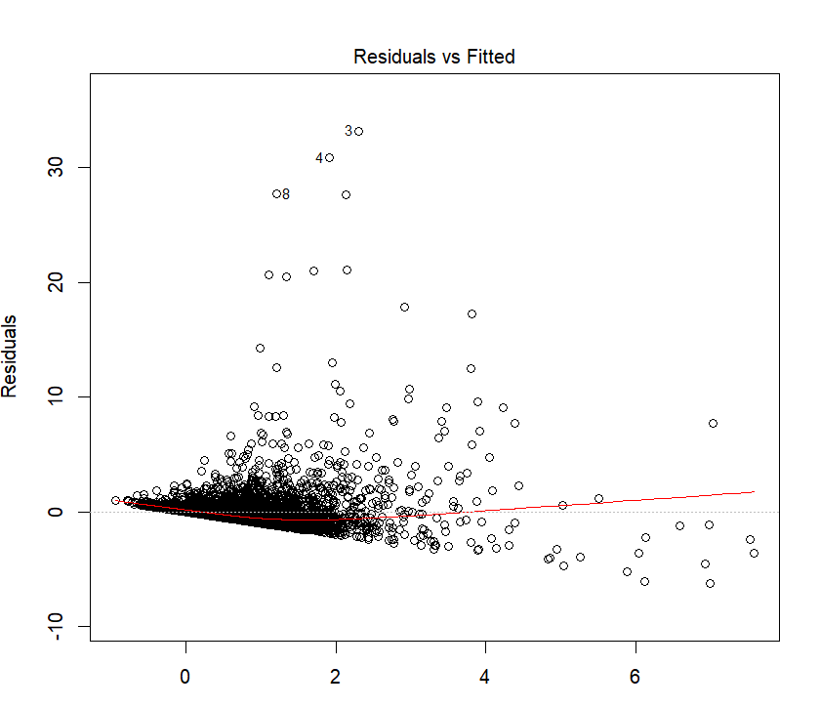
Linear Regression
Test MSE: 6.83

Slide 19
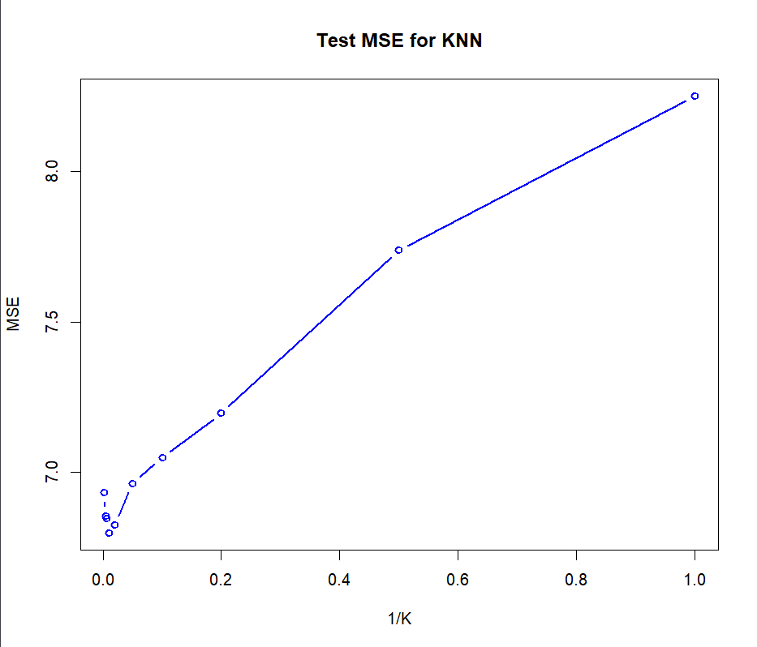
KNN Regression
Value of K: chosen by CV
K = 100
Test MSE: 6.80

Slide 20
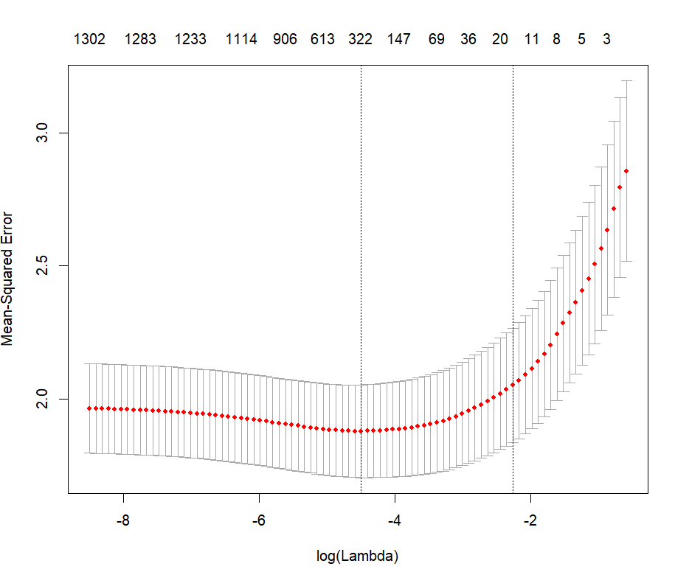
Lasso
lambda = 0.01
Variables:
User_score, Critic_score,
Platform, User_count,
Critic_count, Genre
Lasso test MSE: 5.54

Slide 21
Result
 | OLS | KNN | Ridge | Lasso
Parameter | / | K = 100 | ƛ = 0.003 | ƛ = 0.01
Training MSE | 2.31 | 2.26 | 2.185 | 1.52
Test MSE | 6.83 | 6.80 | 6.612 | 5.54
Test MSE is much bigger than Training MSE. All the models seems to be overfitting.

Slide 22
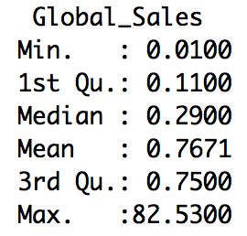
Result
Use Lasso.
Test MSE 6.612 might be too large.
Probable Reasons for the result:
From the Global_Sales vs yeas plot, it shows that the part before 2002 has a big change after na.omit. The missing of that part of data might influence the accuracy of model.
The sales of only 20 games are above 20. Most are below 5. The high-sales popular games, as outliers, are sensitive to model prediction.
The amount of critical and user counts, in hundreds, are of low proportion in comparison with the sales in millions. So the statistics is not comprehensive.
Game players tend to rate the best and the worst game.

Slide 23
THANKS
!
Youka

Slide 24

TITLE HERE
TEXT HERE
TEXT HERE
TEXT HERE
YoukaPPT
TEXT HERE
TEXT HERE
TEXT HERE

Slide 25
PART TWO
ADD YOUR TITLE HETE

Slide 26
TITLE HERE
10%
TEXT HERE
TEXT HERE
40%
20%
TEXT HERE
TEXT HERE
10%
YoukaPPT
10%
TEXT HERE
TEXT HERE
10%

Slide 27

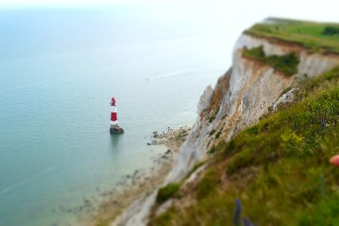

TITLE HERE
TEXT HERE
You cannot improve your past, but you can improve your future. Once time is wasted, life is wasted. Do one thing at a time, and do well.
TEXT HERE
You cannot improve your past, but you can improve your future. Once time is wasted, life is wasted. Do one thing at a time, and do well.
TEXT HERE
You cannot improve your past, but you can improve your future. Once time is wasted, life is wasted. Do one thing at a time, and do well.

Slide 28
PART THREE
ADD YOUR TITLE HETE

Slide 29
TITLE HERE
75%
78%
63%
83%
TEXT HERE
TEXT HERE
TEXT HERE
TEXT HERE
Do one thing at a time and do well.
Do one thing at a time and do well.
Do one thing at a time and do well.
Do one thing at a time and do well.

Slide 30
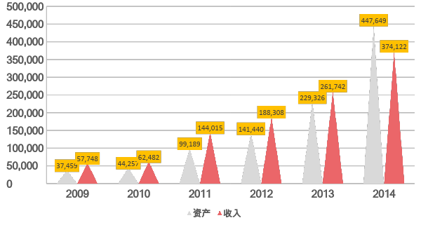
TITLE HERE

Slide 31
PART FOUR
ADD YOUR TITLE HETE

Slide 32
TITLE HERE
TEXT HERE
TEXT HERE
TEXT HERE
TEXT HERE
Do one thing at a time and do well.
Do one thing at a time and do well.
Do one thing at a time and do well.
Do one thing at a time and do well.

Slide 33
TITLE HERE
You cannot improve your past, but you can improve your future. Once time is wasted, life is wasted. Do one thing at a time, and do well.
You cannot improve your past, but you can improve your future. Once time is wasted, life is wasted. Do one thing at a time, and do well.
.JPG
.JPG
You cannot improve your past, but you can improve your future. Once time is wasted, life is wasted. Do one thing at a time, and do well.
You cannot improve your past, but you can improve your future. Once time is wasted, life is wasted. Do one thing at a time, and do well.
.JPG
.JPG

Slide 34
THANKS
!
Youka

